Slide 1
The role of the Enhanced Recovery After Surgery Physiotherapist

Slide 2
What is Prehabilitation?
Prehabilitation is an element of rehabilitation where your journey to recovery starts before surgery has begun through:
Physical support
Nutritional support
Psychological support
It introduces some steps you can take to help you prepare for your upcoming surgery. The actions you take now can help you recover more quickly and reduce the time you spend in hospital.

Slide 3
The Benefits of Prehabilitation:
Reduce length of stay in hospital
Enhance recovery following treatment
Reduce post op complications
Improve fitness
Enhance quality of life

Slide 4
Physiotherapy Input:
The role of physiotherapy within ERAS pathways is important in both pre-operative and post-operative routines. Pre-operative Physiotherapy will focus on:
1. Getting active
2. Improving muscle strength
3. Chest care

Slide 5
1. Getting active
Getting active now will help train your body for major surgery. Similar to how an individual would train and prepare their body in the weeks leading up to a major sporting event in order to prevent injury and recover as soon as possible, we would like you to train your body before your upcoming operation to minimise the health risks after your surgery and to help you recover more quickly. Improving your current level of fitness before a major operation will help minimise the risks of infections after your surgery and will help you have a healthy recovery.

Slide 6
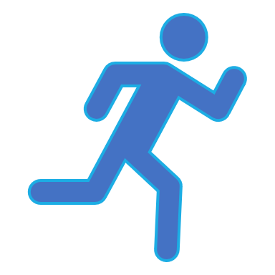
A target of 30 minutes of aerobic exercise at least 5 days a week at a moderate intensity – where you are slightly short of breath but can still talk.
Below are some suggestions to achieve:
Moderate/brisk walking
Jogging
Swimming
Cycling
Your activity can be spread out across your day. If you haven’t done much physical activity for a while you may want to get the all clear from your GP before starting.

Slide 7
2. Improving muscle strength
In addition to cardiovascular activity it is important to improve muscle strength. A greater proportion of muscle mass will help your recovery. Resistance based exercises are key to increased muscle mass. Ideally you should do 2 sessions of strength training a week.
Below are examples of muscle strengthening exercises:
Lifting weights: small dumbbells, cans of food, water bottles.
Body weight exercises, squats, lunges, sit to stands, wall sits.
Completing your aerobic exercises with added resistance e.g. a full back pack or carrying bottles of water/poles in each hand.
Working with resistance bands.
Push ups/sit ups.

Slide 8
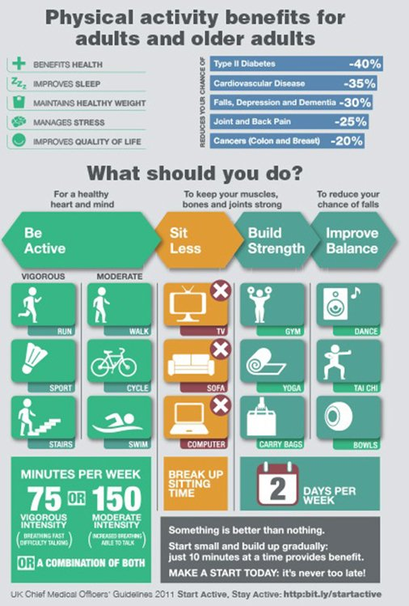
Remember the larger muscle groups will show the quickest and largest response to resistance training. These large muscles are used to help you mobilise and the stronger they are before surgery the sooner you will be able to get out of bed following your operation.
For more information please see:
Move more: Your guide to becoming more active. Visit https://www.macmillan.org.uk/cancer-information-and-support/treatment/preparing-for-treatment/eating-well-and-keeping-active
Get active your way NHS. Visit https://www.nhs.uk/live-well/exercise/get-active-your-way/

Slide 9
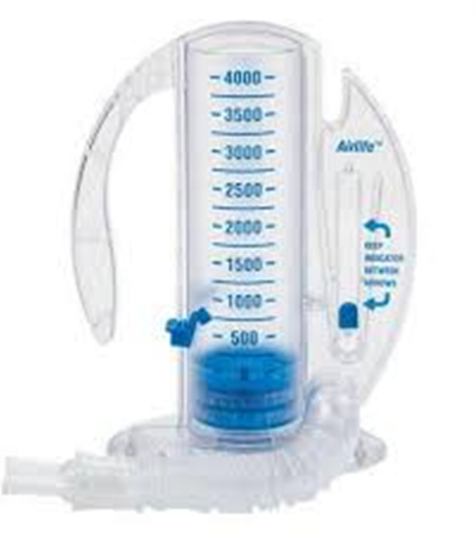
3. Chest Care
Incentive Spirometer:
Due to effects of general anaesthesia on your lungs there is an increased risk of developing respiratory complications with major surgery. You will be provided with an Incentive Spirometer by your Physiotherapist and instructed in its use.
Before surgery: Aim to complete at least 4 times a day in order to ‘train’ your lungs in preparation for surgery (ideally 2-4 weeks before your operation)
After surgery: Complete hourly until your mobility is back to normal. Patient ERAS Diary suggests 4-5 breaths = 1 cycle. Total of 3 of these each day.

Slide 10
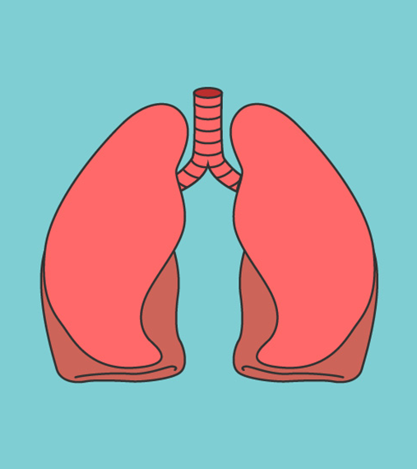
Why is it important to use an Incentive Spirometer?
Before surgery it:
Increases lung capacity
Trains you to take deep breaths
Prepares your lungs for surgery
After surgery it:
Re-opens the bottom of the lungs after surgery
Encourages the movement of phlegm out of your lungs so you can cough it up
Reduces the risk of infections
Reduces your hospital stay and speeds up your recovery
For more information on using the incentive spirometer please click on the link below:
https://www.youtube.com/watch?v=KbXzUFjFnKE

Slide 11
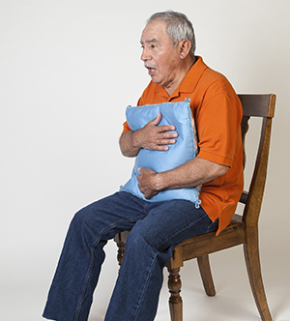
Deep breathings exercises and coughing:
After surgery taking deep breaths and coughing will helps to clear your lungs. This helps the lungs do the vital job of delivering oxygen to the tissues in your body.
You must cough effectively after surgery to clear secretions and open your lungs properly to avoid the risk of secondary infection.
If you have an incision, support your incision when coughing by placing a pillow firmly against it and make sure your pain is well controlled.

Slide 12
Enhanced Recovery After Surgery (ERAS) post operative information for Colorectal patients:
Your first few days at home:
Once you are home you may find that walking around your home and up/downstairs tires you more easily, but this is normal and will ease with time. We recommend that you follow the same routine that you had on the ward.
Walking:
We recommend walking as the best way to keep up your fitness. Aim to potter around the house every day and, throughout the day. Then, weather permitting, start to go outside for walks when you feel up to it.
Getting in and out of bed:
To get out of bed for the first 6 weeks after your operation we recommend ‘log rolling’ as it reduces the stress and pain over your abdominal wound. The ‘log rolling’ technique involves keeping your knees bent, then rolling onto your side, allowing your legs and feet to drop over the edge of the bed. Using your arms and hands push yourself up into a sitting position on the ned. Reverse the procedure to get back into bed.

Slide 13
Discomfort:
Some discomfort around the wound is normal after surgery. Sleeping with a pillow under your knees may help to reduce pain when you are lying in bed by reducing the stretch to your wound. Taking regular painkillers as prescribed by your team or healthcare professionals will help to ease any pain and allow you to be more mobile, sleep and also continue with your deep breathing exercises.
Lifting:
No lifting is recommended for the first 6 weeks following your surgery. This allows your body time to heal. Do not lift anything heavier than a full 3 pint kettle (3-4kgs or 6-8lbs). If the activity makes you hold your breath or grunt during due to the effort required, then please refrain from that activity.

Slide 14
Household tasks and gardening:
Take things at your own pace. Concentrate on becoming more active but at the pace your body allows you to.
Physical activity:
Returning to fitness after your operation may take at least 12 weeks.
For your first 4 weeks at home you can do light activities such as washing up, light dusting and easy household jobs.
After 4-6 weeks you can begin to include vacuuming, ironing and cooking.
After 6 weeks you will have an outpatient review where you will be told whether you can resume normal activities which may include gardening.

Slide 15
After 8 weeks at home more strenuous activities such as golf, jogging, aerobics and cycling and most other sports can be started but within your physical limits. If in doubt, please check with your Consultant/ERAS Physiotherapist.
Sport and Hobbies:
If you have a stoma you will need to wear a stoma support belt before resuming any sport, please discuss this with your stoma nurse.
24 hours post operatively – walking on the flat
After 4 weeks at home – low impact exercises are okay. For e.g. hill walking.
For further support and advise on physical activity, please contact the ERAS Physiotherapist on 07551041372.

Slide 16
Driving:
Do not drive for 5-6 weeks after your surgery. You must ensure that you are able to make an emergency stop safely and control your car safely at all times. Please check with your car insurer for any exclusion clauses related to major surgery. Check with you GP if you are in doubt. You can also contact the DVLA for advice on www.dvla.gov.uk or call 0870 600 0301.
Posture, wound healing and massage:
After your operation you should maintain a good posture by not allowing yourself to stoop when you are stood or when walking. Once your wound has healed, you can stretch your abdomen by lying flat on your back and as your discomfort reduces lying on your tummy. This may not be possible if you have a stoma. Make sure your stoma bag is empty before trying this. Massaging the wounds with moisturiser will help to reduce the risk of tight scar formation. Use the palm of your hand to massage the top layer of skin in circular motions.

Slide 17
Returning to work:
Your GP will be able to give you advice about going back to work and advise you on when to return to work.
Sexual Intercourse:
If you have had any form of anal surgery, please discuss this with your Consultant at your outpatient review appointment. This review usually takes place about 4-6 weeks after your operation.

